Slide 1

Oil and Gas Asset Management Analysis
Batch -3
Harsh Sharma

Slide 2
Problem Statement
In the dynamic landscape of the global upstream oil and gas industry, understanding the historical trends and future projections is essential for informed decision-making and strategic planning
Despite the vast amount of data available through UCube Global, there remains a need to harness its potential to address critical challenges and opportunities within the sector.
The goal is to uncover insights that can drive macro analyses, inform market strategies, aid in company valuation, facilitate business development, and shed light on the oil service industry's market dynamics.

Slide 3
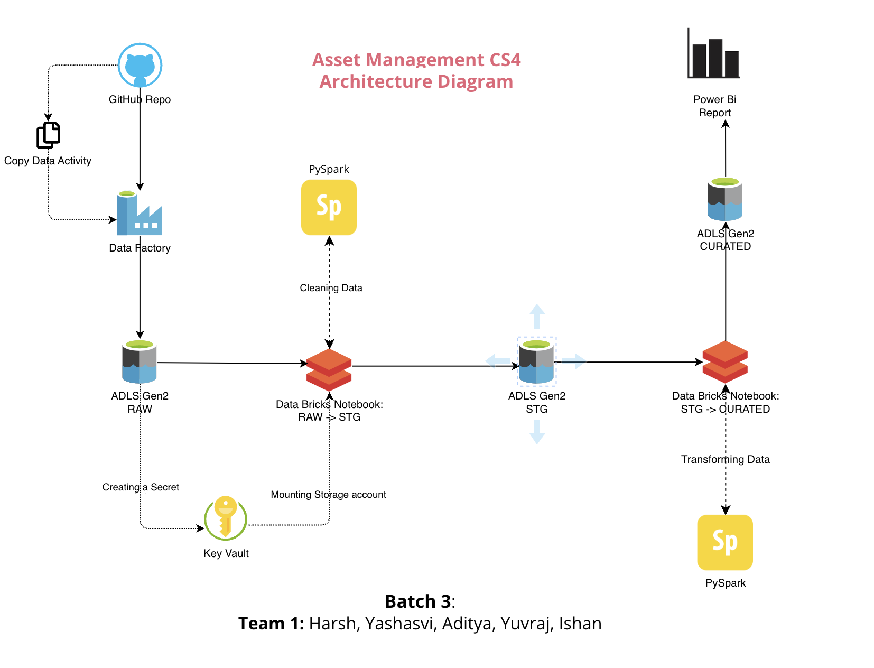
Architecture And Data Flow Diagram

Slide 4

developments in each layer

Slide 5
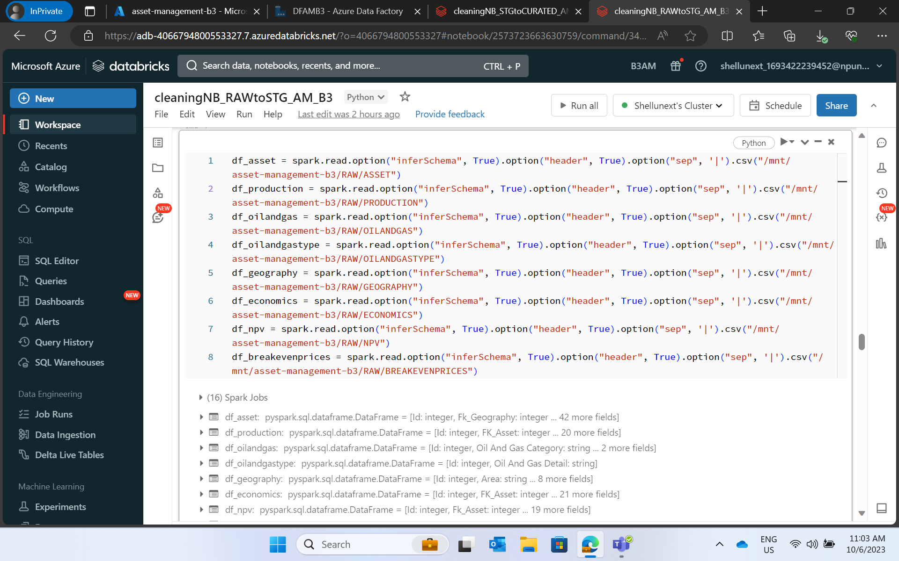

Slide 6
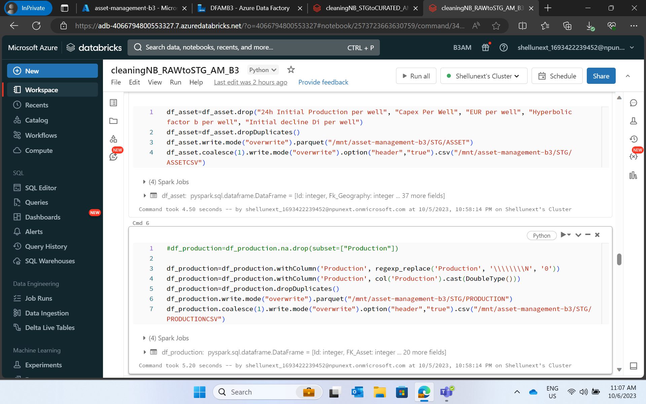

Slide 7
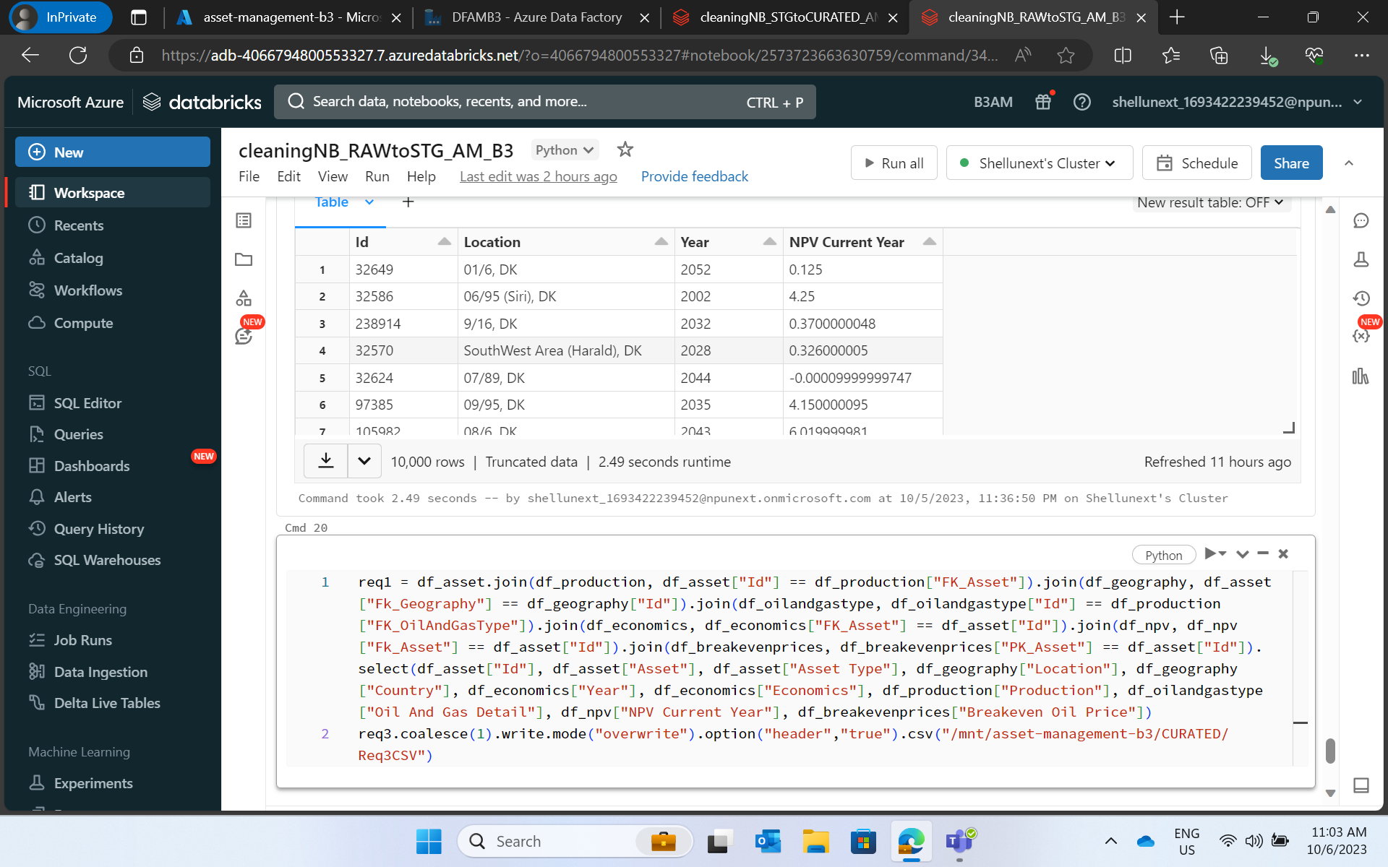

Slide 8
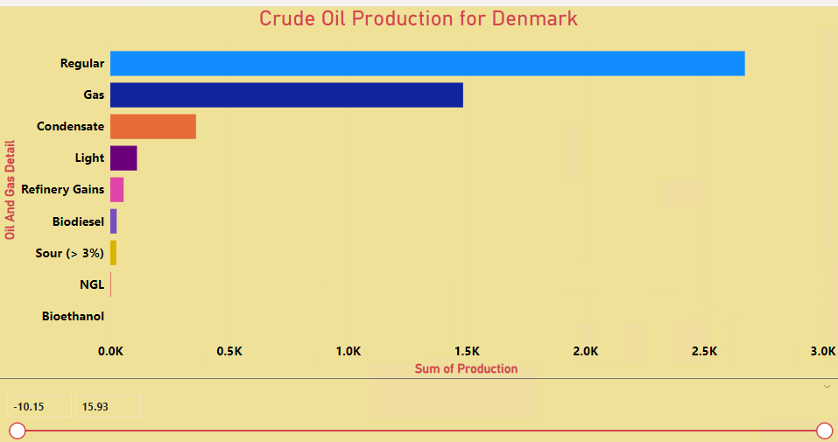
PowerBI Screenshots
How much crude oil will be produced in Denmark?

Slide 9
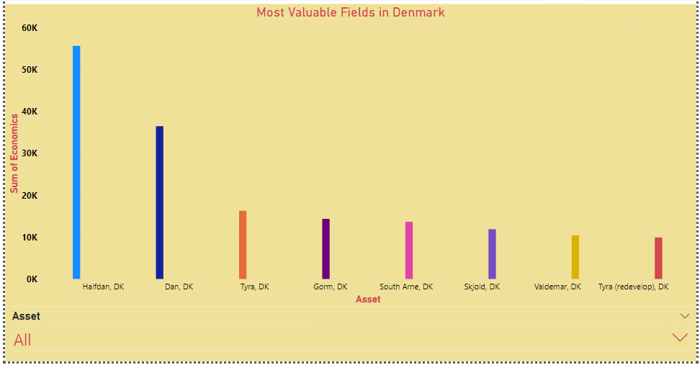
Which are the most valuable fields in Denmark's portfolio?

Slide 10
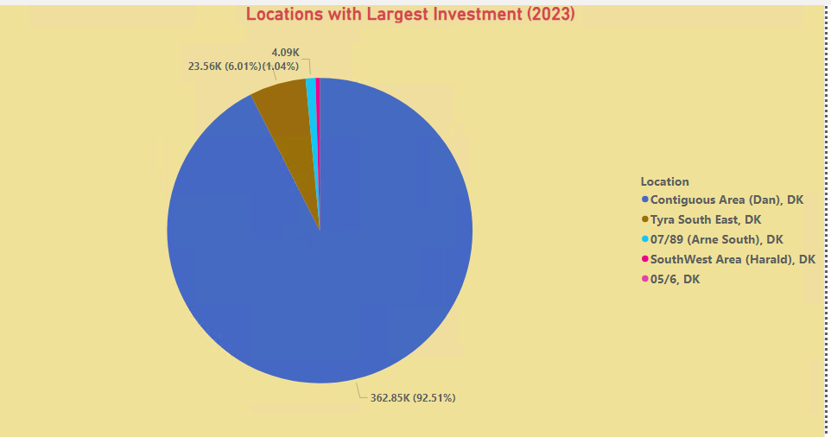
Which Locations will see the largest investments in oil and gas in 2023?

Slide 11
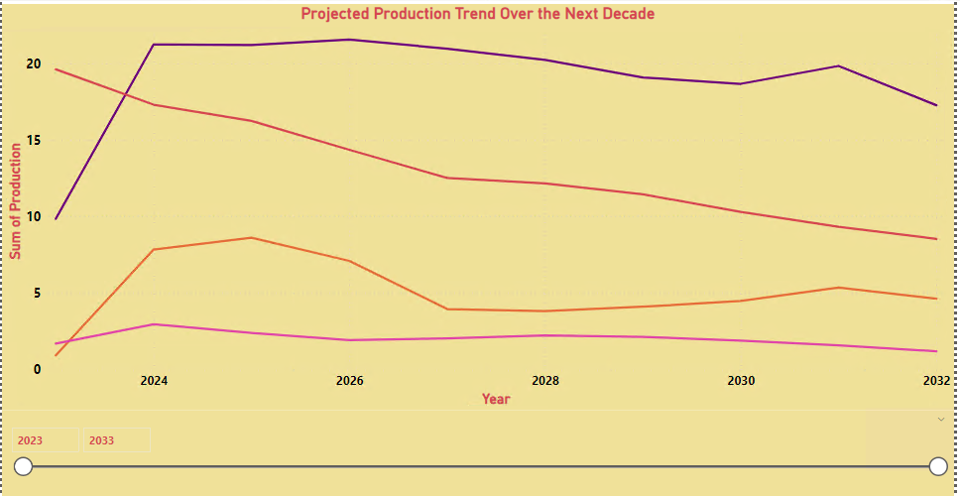
What is the projected production trend of crude oil in Denmark over the next decade, considering various price scenarios?

Slide 12
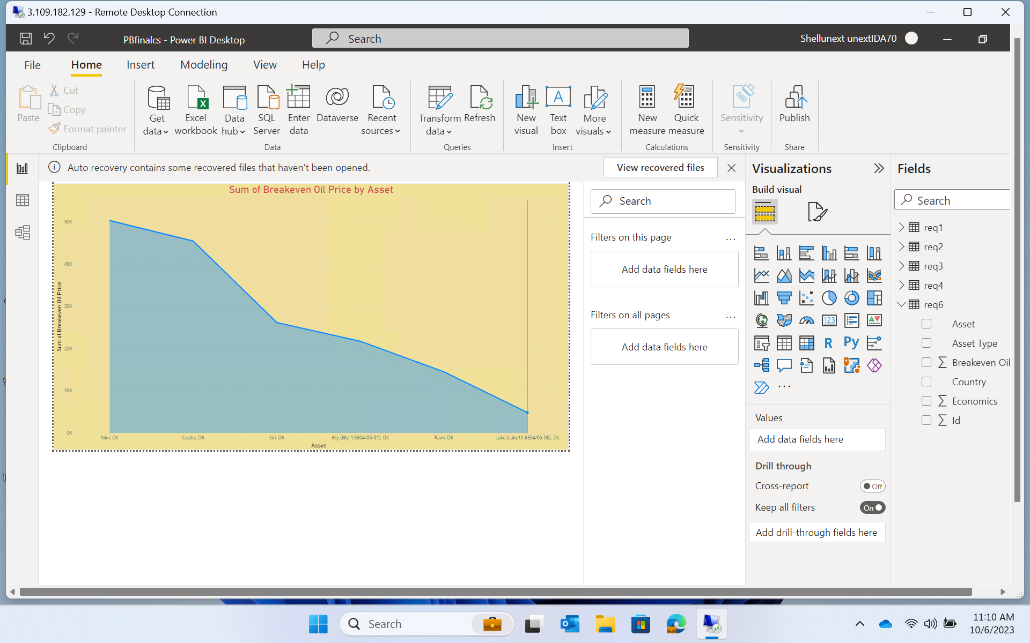
Compare the breakeven oil prices across different valuable fields in Denmark's portfolio

Slide 13
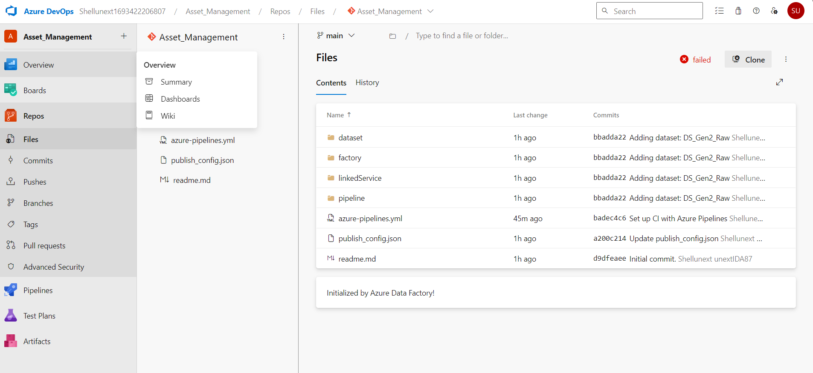
Azure DevOps

Slide 14
GitHub Link
https://dev.azure.com/Shellunext1693422206807/_git/Asset_Management

Slide 15
Challenges Faced And Learnings
The data was quite vast, so a lot of data processing before we can produce any valuable insights, analysis and visualization.
To increase the efficiency, we only selected the data tables which were crucial to the problem statement
Problem Statement required the integration of different Azure services, So time management was of the key factor which helped us implement the solution in an effective manner

